Slide 1
Detecting Diabetic Retinopathy Detection With Deep Learning

Slide 2
What is DR ?
When high blood sugar levels cause damage to blood vessels in the retina. These blood vessels can swell and leak. Or they can close, stopping blood from passing through. Sometimes abnormal new blood vessels grow on the retina. All of these changes can steal your vision.
Affects up to 80 percent of people who have diabetes for 20 years or more
90% of new cases are reducible

Slide 3
DATA
The data originates from a 2015 Kaggle competition. However, is an atypical Kaggle dataset. In most Kaggle competitions, the data has already been cleaned, giving the data scientist very little to preprocess. With this dataset, this isn't the case.
All images are taken of different people, using different cameras, and of different sizes. Pertaining to the preprocessing section, this data is extremely noisy, and requires multiple preprocessing steps to get all images to a useable format for training a model.
The training data is comprised of 35,126 images, which are augmented during preprocessing.

Slide 4
The data originates from a 2015 Kaggle competition.
All images are taken of different people, using different cameras, and of different sizes. Pertaining to the preprocessing section, this data is extremely noisy, and requires multiple preprocessing steps to get all images to a useable format for training a model.
The training data is comprised of 35,126 images, which are augmented during preprocessing.

Slide 5
A left and right field is provided for every subject. Images are labeled with a subject id as well as either left or right (e.g. 1_left.jpeg is the left eye of patient id 1).
A clinician has rated the presence of diabetic retinopathy in each image on a scale of 0 to 4, according to the following scale:
0 - No DR
1 - Mild
2 - Moderate
3 - Severe
4 - Proliferative DR

Slide 6
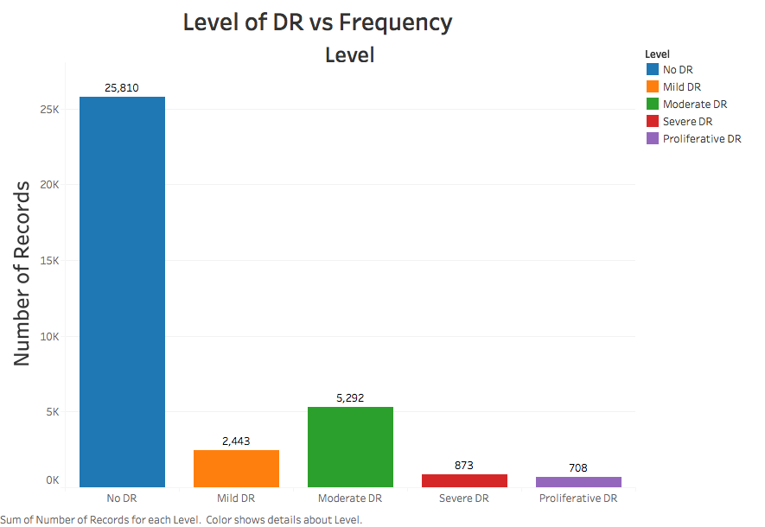

Slide 7
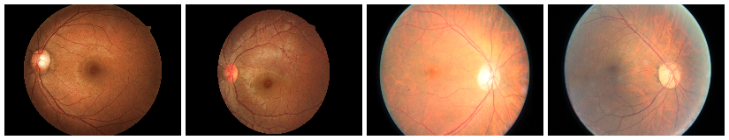
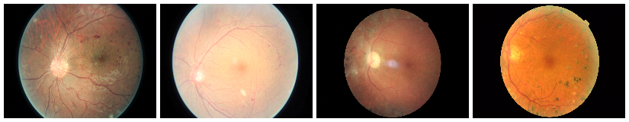
class 0 (no retinopathy)
class 4 (proliferative retinopathy)

Slide 8
Preprocessing
The preprocessing pipeline is the following:
Crop & resize all images using the resizing script and the preprocessing script.
Rotate & mirror all images using the rotation script.
Convert all images to array of NumPy arrays, using the conversion script.

Slide 9
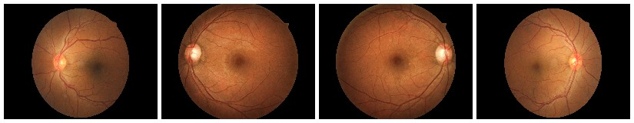
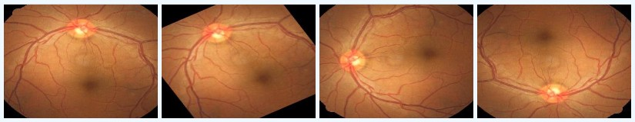

Slide 10
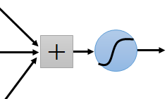
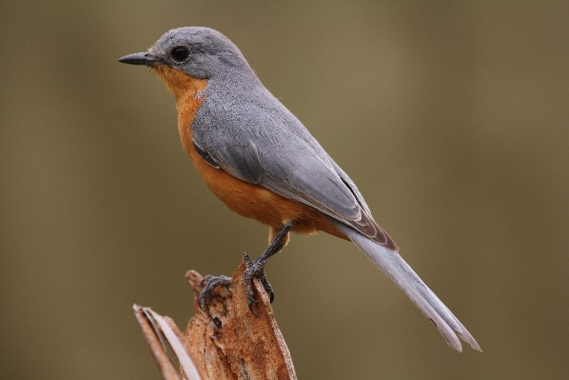



CONVOLUTIONAL NEURAL NETWORK
Learning an image
Some patterns are much smaller than the whole image
Can represent a small region with fewer parameters
source:https://cs.uwaterloo.ca/~mli/Deep-Learning-2017-Lecture5CNN.ppt

Slide 11


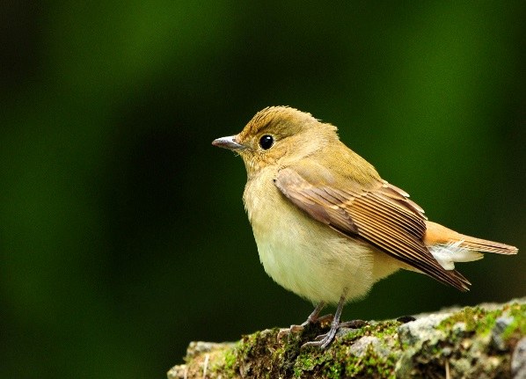
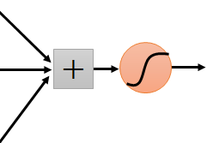
Same pattern appears in different places:They can be compressed!
What about training a lot of such “small” detectors and each detector must “move around”.
They can be compressed
to the same parameters.
source:https://cs.uwaterloo.ca/~mli/Deep-Learning-2017-Lecture5CNN.ppt

Slide 12
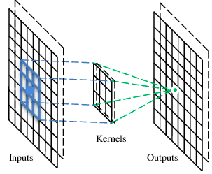
A convolutional layer
A CNN is a neural network with some convolutional layers (and some other layers). A convolutional layer has a number of filters that does convolutional operation.
Beak detector
source:https://cs.uwaterloo.ca/~mli/Deep-Learning-2017-Lecture5CNN.ppt

Slide 13
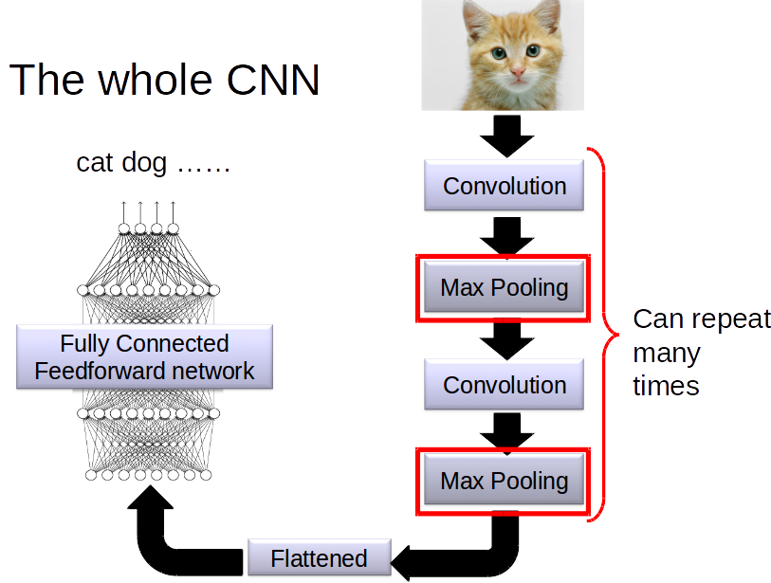
source:https://cs.uwaterloo.ca/~mli/Deep-Learning-2017-Lecture5CNN.ppt

Slide 14
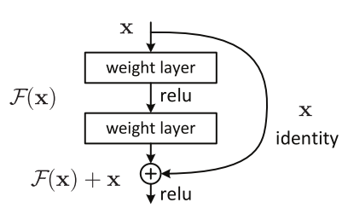
Model : Resnet
Fig: Residual block

Slide 15
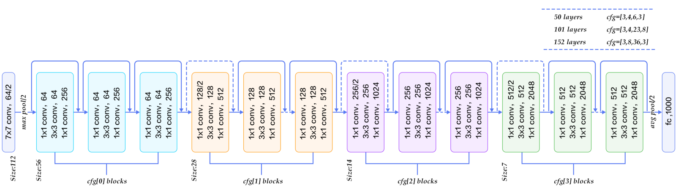
Transfer learning with resnet50

Slide 16
Results
S. No. | Model | #samples | #epochs | Val. accuracy | Test accuracy
1 | resnet50 (only classifier trained) | 8006 | 20 | 71.64% | 69.154%
2 | resnet50 (fc layer trained) | 8006 | 16 | 73.58% | 69.075%

Slide 17
Thank you……...

